Slide 2
FIRST TERM SCHEME OF WORK FOR JSS TWO
COMPUTER STUDIES
WEEKS | content
1 | REVISION / CLASSIFICATION OF COMPUTERS
2 | THE COMPUTER SYSTEM
3 | HARDWARE COMPONENTS
4 | SOFTWARE
5 | PEOPLE WARE
6 | OPERATING SYSTEM
7-8 | NUMBER BASES
9 | CONVERSION OF NUMBER BASES
10 | UNITS OF STORAGE IN COMPUTER
11 | REVISION
12 | EXAMINATION

Slide 3
CLASSIFICATION OF COMPUTER
Week One

Slide 4
Classification by size
The following computers are classified by their size
Micro Computer
Mini Computer
Mainframe Computer
Super Computer

Slide 5
Micro computer
Also personal computer (PC) uses a single microprocessor mounted with memory chips as its central processing units (CPU) .examples of microcomputer are desktop computer, laptops and palmtops.

Slide 6
Mini computer
They are larger than the micro computer in size and in storage capacity. They are stand-alone computers used by business and enterprises for department- level operation.

Slide 7
Mainframe
They are the largest in range of computers. They are also large in storage capacity. They have multiple chips and can handle large amount of processing and allow many users at a time.
They make use of the magnetic tape and disk mass data storage purpose

Slide 8
Super computer
This performs at a speed which is far above that of other computers
They are sophisticated and powerful .they perform highly complex and time consuming computation faster and speed .

Slide 9
CLASSIFICATION OF COMPUTER
By degree of versatility

Slide 10
General purpose computer
These are computer designed to perform in a reasonable efficient manner ,the functions required both scientific and business application. They are capable of handling variety of tasks.

Slide 11
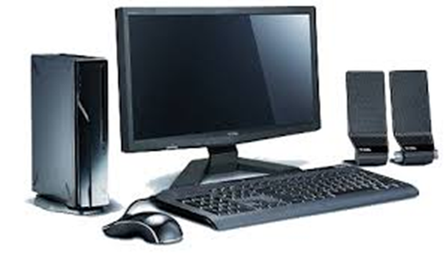
Example of the general purpose computer
The micro computer

Slide 12
Special purpose computer
They are computers designed from the scratch to perform a specific function .

Slide 13
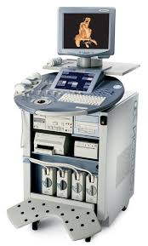
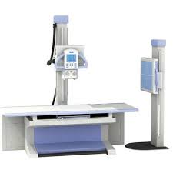
Examples
The ultrasound machine.
The X-ray generator.

Slide 14
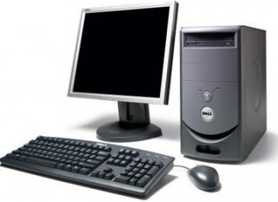
THE COMPUTER SYSTEM
THE CONCEPT OF COMPUTER SYSTEM
WEEK 2

Slide 15
Definition of Computer
Computer is an electronic device that has the capability to accept data through the keyboard, process it on the system unit and produce meaningful information on the monitor or printer with the aid of a stored program.
Computer can be refer to as Information processor.

Slide 16
Computer as a device accept data that is being inputted into it through the keyboard or any other input device; it then takes the data for processing and displays the result in the form of information

Slide 17
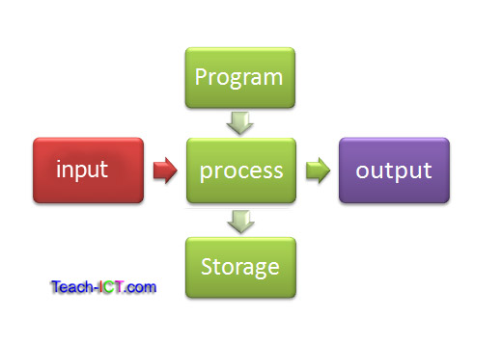
Therefore ,in a computer system ,there are three subsystems and they are
Input
Processing
Output

Slide 18
Whatever that is being entered into the computer as input determine the output .
This brings us to a term in computer ;
Garbage in, Garbage out (GIGO)

Slide 19
COMPONENTS OF A COMPUTER SYSTEM
There are three components of a computer system which will determine the performance of the computer. They are
Hardware
Software
People-ware

Slide 20
THE HARDWARE COMPONENTS
WEEK 3

Slide 21
Definition
The hardware components is the physical parts of the computer which can be touched and seen. The computer hardware is responsible for performing four basic functions.:-
Input
Processing
Output
storage

Slide 22
The hardware also includes
The CPU which comprises of the ALU, control unit and the memory unit
Input devices
Output devices

Slide 23
The central processing unit (CPU)
It is solely responsible for the processing of data and instructions in the computer system.it encompasses the following

Slide 24
Arithmetic And Logic Unit –
Which handles arithmetic and logical operations such as addition, subtraction, multiplication, division etc.
Control Unit –
This controls all other parts ,components of the system by issuing instructions In form of signals.
Memory Unit-
stores data and instructions that is about to be processed. There are 2 major types of storage

Slide 25
PRIMARY STORAGE
The primary storage is divided into the following
ROM (Read Only Memory)
RAM (Random Access Memory)

Slide 26
ROM
ROM(Read only memory):- once this memory is programmed ,it can not be re-written.it contains the Boot record

Slide 27
RAM
RAM(Random Access Memory) :- the computer can read from this memory, store/write on it

Slide 28
SECONDARY STORAGE
They store information/data/programs permanently. They are mainly used for backup. Examples are magnetic tapes/disks, floppy disk, Compact disk, flash drive, zip drive, hard drive etc.

Slide 29
Input devices
These are used to communicate with the computer. They are devices through which data is sent into the computer system .Examples of these devices are mouse, joystick, digital camera, web camera, light pen, keyboard.

Slide 30
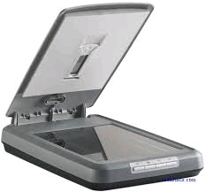
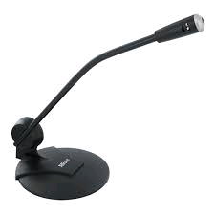
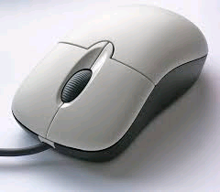
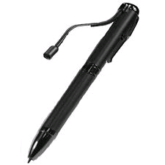

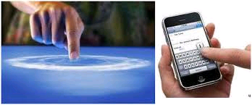
Scanner mouse microphone
light pen web camera touch screen

Slide 31
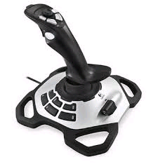
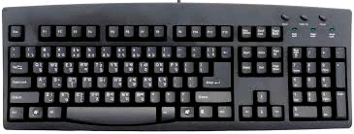
Joystick keyboard

Slide 32
Output devices
These are devices that the computer uses to bring out result o information. They are responsible for the display or output of the processed data .
Examples of output devices are

Slide 33



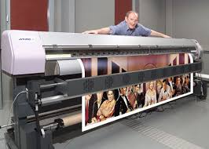

Monitor Printer Projector
Plotter Speakers

Slide 34


SOFTWARE
WEEK 4

Slide 35
Software is the collection of computer programs, procedures and documentation that perform different tasks on the computer system.
The software is a program written by a programmer of software developer.
A program is a list of instructions given to the computer to perform a particular task.

Slide 36
Types of software
SYSTEM SOFTWARE
This is a computer software designed to operate the computer hardware and to provide and maintain a platform for running application software.
There are 2 major types of system software
The operating system :- it runs on the computer, manages the computer hardware, controls and co-ordinates all activities within the computer system. Example of operating system is the MS windows.

Slide 37
Utility Software:-
They are system software designed to help analyze, configure ,optimize, and maintain the computer system.
Examples of Utility software are -Antivirus, Disk compression, ScanDisk, BackUp-utilities, Norton Utilities.

Slide 38
Application Software
These are software designed to perform specific functions. The application software is written to solve a particular problem. Examples are
Word processing software :- (e.g. MS Word) it is used to create and edit documents such as letters, reports ,letter-head etc.
spreadSheeet Software :- (eg MS Excel)are used for mathematical ,statistical ad accounting purpose.

Slide 39
Graphical Software (e.g. Corel draw, MS Paint) :- are used for graphic works such as drawing, Painting and artistic images .
Database Management Software (e.g. MS Access)
this is used to keep records such as student’s name ,class, age, etc.
Games software (e.g.. Car Race,football) :- they are used for entertainment and relaxation purpose.
Presentation Software ( e.g. MS power point ) : they are used for displaying information in slides. They are used for educational purpose, presentation and seminar, entertainment, teaching etc.

Slide 40

PEOPLE-WARE
WEEK 5

Slide 41
People ware can refer to anything that has to do with the role of people in the development or use of computer software and hardware systems.people ware can be divided into two distinct groups such as :
Computer Professionals
Computer Users

Slide 42
Computer Professionals
These are individuals who have in one way or the other acquired formal education or training in the use of computers e.g.
Computer Managers
Computer Programmers/software Developers
Computer operators
Computer Engineers
System Analyst
Software Engineers
Database Administrators.

Slide 43
Computer Users
These are the group of people who make use of the computer systems in discharging their day to day activities.
We can simply say they are people who work with the computer. These people May not have any formal training in computer but can engage the services of some computer professionals

Slide 44
OPERATING SYSTEM
WEEK 6

Slide 45
Definition
An operating system (OS) is system software
that manages computer hardware and software
resources and provides common services for
computer programs. The operating system is a
component of the system software in a
computer system. Application programs usually
require an operating system to function.

Slide 46
Examples of operating system
MS-DOS-(Micro soft disk operating system) a simgle user OS
Mac OS
IBM OS/2 Warp
Unix and Variants
Windows CE
Windows 3.x
Windows 95
Windows 98
Windows 98 SE

Slide 47
Windows ME
Windows NT
Windows 2000
Windows XP
Windows Vista
Windows 7
Windows 8
Windows 8.1
Novell Netware -a multi-user operating System

Slide 48
Functions of the operating system
. Resource allocation- it allocate recourses such as CPU time, main memory, secondary storage, input, and output device.

Slide 49
System Monitoring -it monitors jobs submitted for execution to ensure efficient processing

Slide 50
Input/output-it co-ordinates different input and output devices
Memory management-

Slide 51
File management-it help in storage, changing and modification of files.
Interpretation of commands and instructions

Slide 52
Co-ordination of compilers, assemblers, utility programs, and other software
Facilitate easy communication between the computer system and the computer operator(human).

Slide 53
NUMBER BASES
WEEK 7/8

Slide 54
INTRODUCTION
Representation of data in the computer make use of number system.
When the data and instruction is entered into the computer, the computer will convert it into machine language i.e. 0’s and 1’s which are called binary digits

Slide 55
Numbers Bases system
There are different number base systems. These are
Decimal Number system ( Base Ten)
Binary Number system ( Base Two)
Octal Number system ( Base Eight)
Hexadecimal Number system ( Base 16)

Slide 56
Terms in Number base system
Bases – the base of a number indicates the absolute values use in the system. E.g. in Decimal there are ten absolute values represented by 0,1,2,3,4,5,6,7,8,9
Absolute values :- denotes whole numbers represented by a figure e.g. 6,7,8,4,5 etc.
These are values assigned to digits denoting their position. E.g. 2⁶ 2⁵ 2⁴ 2³ 2² 2¹ 2⁰

Slide 57
Exponents
2⁰ = 1
2¹ = 2
2² = 2 x 2 =4
2³ = 2 x 2 x 2 = 8
x⁵ * x¹⁰ = x ¹⁰ ⁺ ⁵ = x¹⁵
1 / x² = x ⁻²

Slide 58
Decimal Numbering systems
Base: 10
Digits: 0, 1, 2, 3, 4, 5, 6, 7, 8, 9
Representation
5234
Thousands Hundreds Tens Units
5 2 3 4

Slide 59
Binary Numbering systems
Base: 2
Digits: 0, 1
binary number: 110101₂
positional powers of 2: 2⁵ 2⁴ 2³ 2² 2¹ 2⁰
decimal positional value: 32 16 8 4 2 1
binary number: 1 1 0 1 0 1

Slide 60
Binary to Decimal Conversion
To convert to base 10, add all the values where a one digit occurs.
Ex: 110101₂
positional powers of 2: 2⁵ 2⁴ 2³ 2² 2¹ 2⁰
decimal positional value: 32 16 8 4 2 1
binary number: 1 1 0 1 0 1
32 + 16 + 4 + 1 = 53₁₀

Slide 61
Assignment :-Binary to Decimal Conversion
101011₂
positional powers of 2: 2⁵ 2⁴ 2³ 2² 2¹ 2⁰
decimal positional value:
binary number:

Slide 62
Binary to Decimal Conversion
Ex: 101011₂
positional powers of 2: 2⁵ 2⁴ 2³ 2² 2¹ 2⁰
decimal positional value: 32 16 8 4 2 1
binary number: 1 0 1 0 1 1
32 + 8 + 2 + 1 = 43₁₀

Slide 63
Decimal to Binary Conversion
The Division Method. Divide by 2 until you reach zero, and then collect the remainders in reverse.
Ex 1: 56₁₀ = 111000₂
2 ) 56 Rem:
2 ) 28 0
2 ) 14 0
2 ) 7 0
2 ) 3 1
2 ) 1 1
0 1

Slide 64
Decimal to Binary Conversion
Ex 2: 35₁₀ =
2 ) Rem:
2 )
2 )
2 )
2 )
2 )
Answer: 35₁₀ = ₂

Slide 65
Octal Numbering systems
Base: 8
Digits: 0, 1, 2, 3, 4, 5, 6, 7
Octal number: 1246₈
powers of : 8⁴ 8³ 8² 8¹ 8⁰
decimal value: 4096 512 64 8 1
Octal number: 1 2 4 6

Slide 66
Octal to Decimal Conversion
To convert to base 10, beginning with the rightmost digit multiply each nth digit by 8^{(n-1)}, and add all of the results together.
Ex: 1246₈
positional powers of 8: 8³ 8² 8¹ 8⁰
decimal positional value: 512 64 8 1
Octal number: 1 2 4 6
512 + 128 + 32 + 6 = 678₁₀

Slide 67
Assignment :-Octal to Decimal Conversion
Ex: 10352₈
positional powers of 8: 8⁴ 8³ 8² 8¹ 8⁰
decimal positional value:
Octal number:

Slide 68
Decimal to Octal Conversion
The Division Method. Divide by 8 until you reach zero, and then collect the remainders in reverse.
Ex 1: 4330₁₀ = 10352₈
8 ) 4330 Rem:
8 ) 541 2
8 ) 67 5
8 ) 8 3
8 ) 1 0
0 1

Slide 69
Decimal to Octal Conversion
Ex 2: 810₁₀ =
8 ) 810 Rem:
8 )
8 )
8 )
Answer: 810₁₀ = ₈

Slide 70
Hexadecimal Numbering systems
Base: 16
Digits: 0, 1, 2, 3, 4, 5, 6, 7,8,9,A,B,C,D,E,F
Hexadecimal number: 1F4₁₆
powers of : 16⁴ 16³ 16² 16¹ 16⁰
decimal value: 65536 4096 256 16 1
Hexadecimal number: 1 F 4

Slide 71
Hexadecimal Numbering systems
Four-bit Group Decimal Digit Hexadecimal Digit
0000 0 0
0001 1 1
0010 2 2
0011 3 3
0100 4 4
0101 5 5
0110 6 6
0111 7 7
1000 8 8
1001 9 9
1010 10 A
1011 11 B
1100 12 C
1101 13 D
1110 14 E
1111 15 F

Slide 72
Hexa to Decimal Conversion
To convert to base 10, beginning with the rightmost digit multiply each nth digit by 16^{(n-1)}, and add all of the results together.
Ex: 1F4₁₆
positional powers of 16: 16³ 16² 16¹ 16⁰
decimal positional value: 4096 256 16 1
Hexadecimal number: 1 F 4
256 + 240 + 4 = 500₁₀

Slide 73
Hexa to Decimal Conversion
Ex: 7E₁₆
positional powers of 16: 16³ 16² 16¹ 16⁰
decimal positional value:
Hexa number:

Slide 74
Decimal to Hexa Conversion
The Division Method. Divide by 16 until you reach zero, and then collect the remainders in reverse.
Ex 1: 126₁₀ = 7E₁₆
16) 126 Rem:
16) 7 14=E
0 7

Slide 75
Decimal to Hexa Conversion
Ex 2: 810₁₀ =
16 ) 810 Rem:
16 )
16 )
Answer: 810₁₀ = ₁₆

Slide 76
Binary Addition & Subtraction
WEEK 9

Slide 77
Addition Rules
0 + 0 = 00 ( 0 with a 0 carry )
0 + 1 = 01 ( 1 with a 0 carry )
1 + 0 = 01 ( 1 with a 0 carry )
1 + 1 = 10 ( 0 with a 1 carry )

Slide 78
Addition Rules
0
+ 0
1
+ 0
0
+ 1
1
+ 1
0 0
0 1
0 1
1 0

Slide 79
Addition Rules w/Carries
0+0+0 = 00 (0 WITH 0 CARRY)
0+0+1 = 01 (1 WITH 0 CARRY)
0+1+1 = 10 (0 WITH 1 CARRY)
1+1+1 = 11 (1 WITH 1 CARRY)

Slide 80
Adding Binary Numbers
0
1
1
1
0
0
0
28
+ 43
71
⎯→ 00011100
⎯→ + 00101011
0
1
0
0
0
1
1
1

Slide 81
Subtraction in Binary
Rules of Binary Subtraction
0 - 0 = 0
0 - 1 = 1, and borrow 1 from the next more significant bit
1 - 0 = 1
1 - 1 = 0

Slide 82
For example,
00100101 - 00010001 = 00010100 | 0 |  | borrows
 | 0 0 1 ¹0 0 1 0 1 | = | 37_{(base 10)}
 | - 0 0 0 1 0 0 0 1 | = | 17_{(base 10)}
 | 0 0 0 1 0 1 0 0 | = | 20_{(base 10)}
00110011 - 00010110 = 00011101 | 0 ¹0 1 |  | borrows
 | 0 0 1 1 0 ¹0 1 1 | = | 51_{(base 10)}
 | - 0 0 0 1 0 1 1 0 | = | 22_{(base 10)}
 | 0 0 0 1 1 1 0 1 | = | 29_{(base 10)}

Slide 83
Binary Multiplication
Rules of Binary Multiplication
0 x 0 = 0
0 x 1 = 0
1 x 0 = 0
1 x 1 = 1, and no carry or borrow bits

Slide 84
For example,
00101001 × 00000110 = 11110110 |  | 0 0 1 0 1 0 0 1 | = | 41_{(base 10)}
 |  | × 0 0 0 0 0 1 1 0 | = | 6_{(base 10)}
 |  | 0 0 0 0 0 0 0 0
 |  | 0 0 1 0 1 0 0 1
 |  | 0 0 1 0 1 0 0 1
 |  | 0 0 1 1 1 1 0 1 1 0 | = | 246_{(base 10)}
00010111 × 00000011 = 01000101 |  | 0 0 0 1 0 1 1 1 | = | 23_{(base 10)}
 |  | × 0 0 0 0 0 0 1 1 | = | 3_{(base 10)}
 |  | 1 1 1 1 1 |  | carries
 |  | 0 0 0 1 0 1 1 1
 |  | 0 0 0 1 0 1 1 1
 |  | 0 0 1 0 0 0 1 0 1 | = | 69_{(base 10)}

Slide 85
Unit of storage in computer
WEEK 10

Slide 86
Definition
Computer data storage, often called storage
or memory, is a technology consisting of
computer components and recording media
used to retain digital data.

Slide 87
The computer memory is a storage location where data and information are kept. The main memory Is divided into two namely:
1. ROM (Read only memory)
2. RAM (Random Access Memory)

Slide 88
Computer understands "0"s and "1"s which are referred to as binary. The "0" stand for OFF and "1" ON meaning electrically discharged and charge state respectively.

Slide 89
The various unit of storage are as follows
Bit :- (binary digit)it is the smallest unit of data/information. E.g. 11011
Nibble:- it is a unit storage that is made up of 4 bits (or half of an octal).
Byte :-this is the smallest unit of information that can be processed.it is an orderly collection of bits, equivalent to 2 nibbles or 8bits (11001101)

Slide 90
Kilobyte :- is use to measure memory space (or memory units)
1000 byte (approx.)=1 kilobyte

Slide 91
The following are conversion rate of unit of storage
8bits = 1 byte
1024 bytes = 1kilobyte (thousands)
1024² bytes = 1 megabyte (millions)
1024³ bytes = 1 Gigabyte (billions)
1024⁴ Bytes = 1 terabyte (trillions)

Slide 92
Word
A word is the smallest unit of information, that can be transferred at a time. A word is made up of two bytes I.e. 4 nibbles or 16 bits

Slide 93
Double word
Double word
This is equivalent to 2 words which is 4 bytes (32 bits)

Slide 94
Quad Word
This is equivalent to 4 words I.e. 2 double words . Which is 8 bytes (64 bits).

